Slide 1
Sales by Day of the Week
An analysis of 2023 Total, Drive Thru and Breakfast sales
on each day of the week

Slide 2
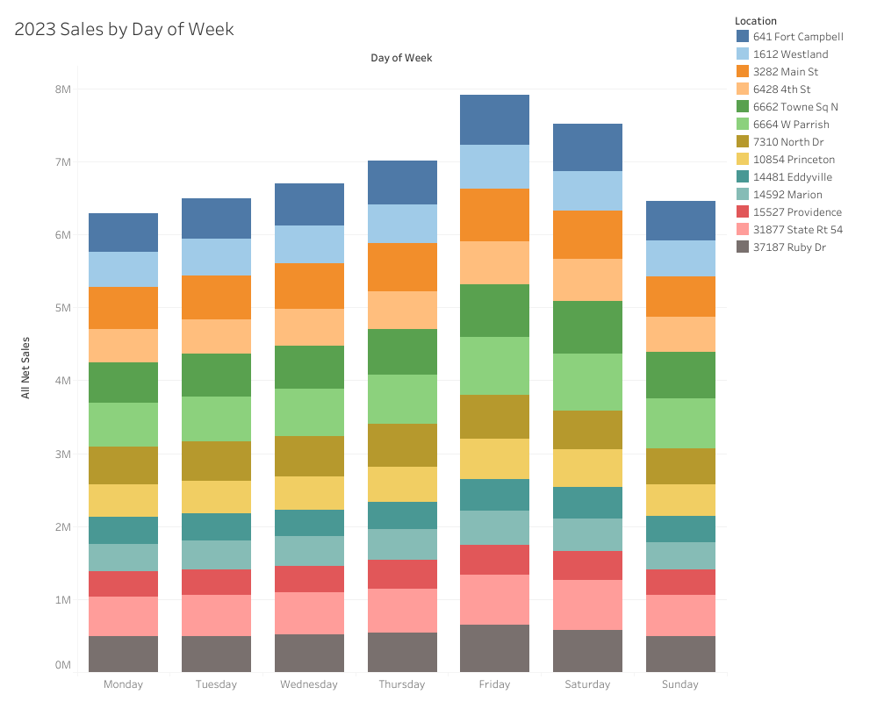

Slide 3
Analysis of previous chart
Friday has the highest number of sales.
Monday has the lowest number of sales.
Sales steadily increase during the work week peaking at Friday.
Sunday sales are the second lowest.
~14% increase in sales from Thursday to Friday.

Slide 4
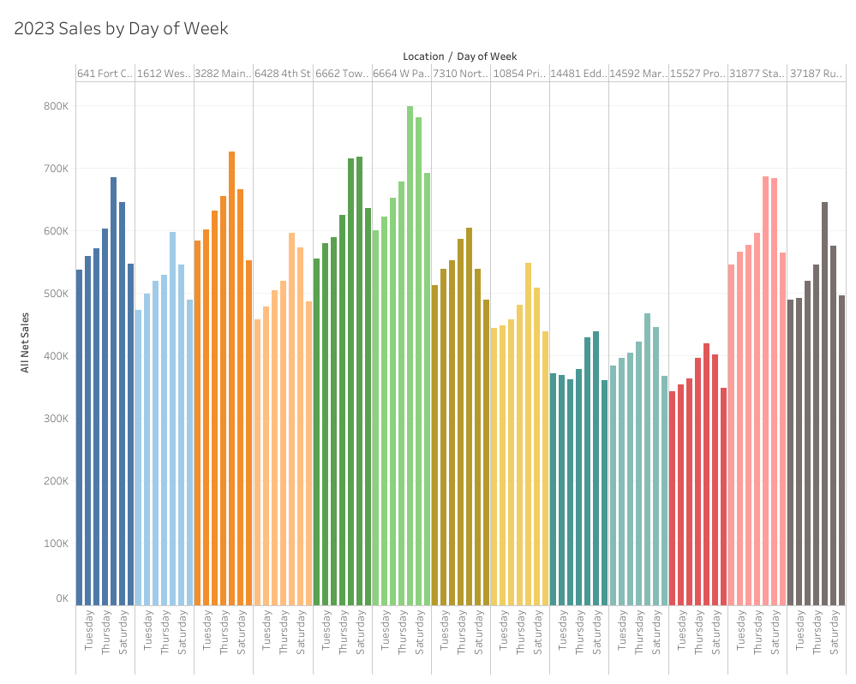

Slide 5
Analysis of previous chart
Each store follows about the same trend as discussed in the last slide.
Eddyville and Towne Sq N have their highest sales on Saturday.
St Rt 54 Friday and Saturday sales are almost the same.
Westland, Main Street and Ruby Drive have significantly higher sales on Fridays than other days.

Slide 6
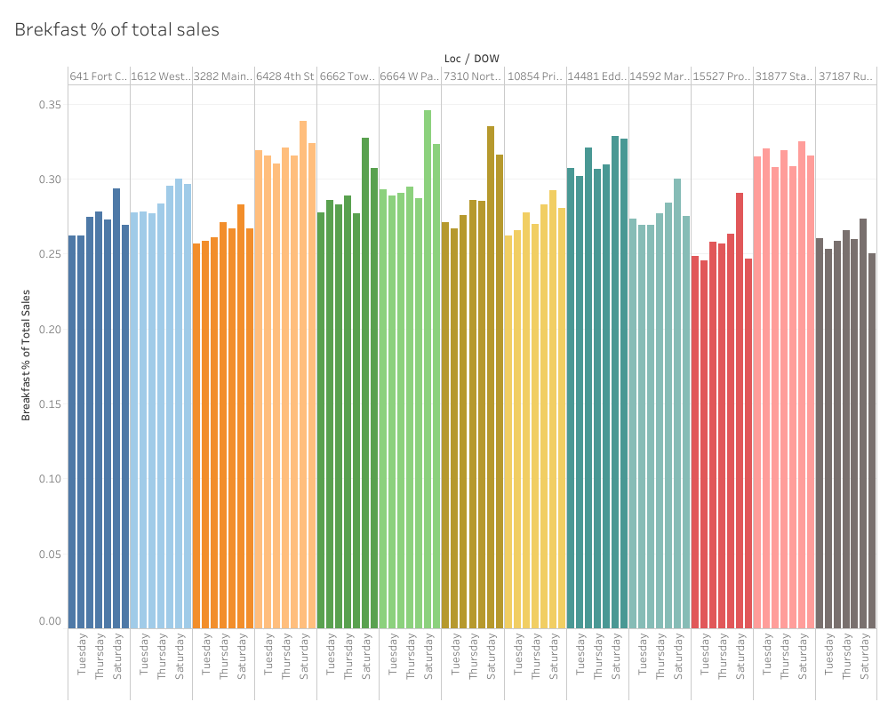
Breakfast % of total sales

Slide 7
Analysis of previous chart
4th St. (6428), State Rt 54 and Eddyville consistently have breakfast sales over 30% (see next slide).
Ruby Drive, Providence and Main street have the lowest percent of breakfast sales.
Towne Sq North, Parrish and North Drive have significant spikes in breakfast sales on Saturdays and Sundays. (See in two slides).

Slide 8
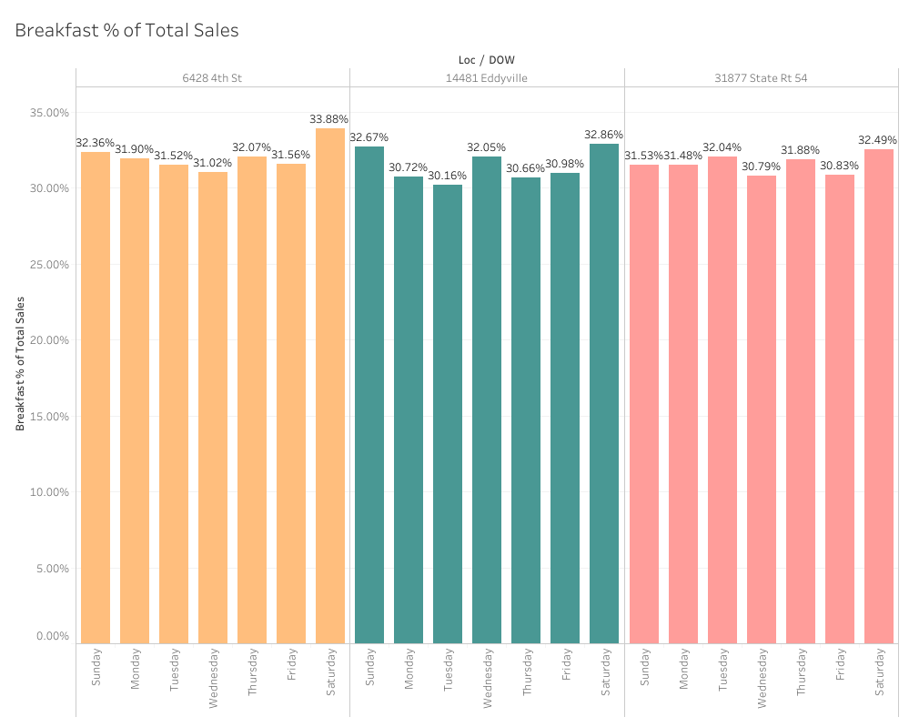
Breakfast Sales consistently over 30%

Slide 9
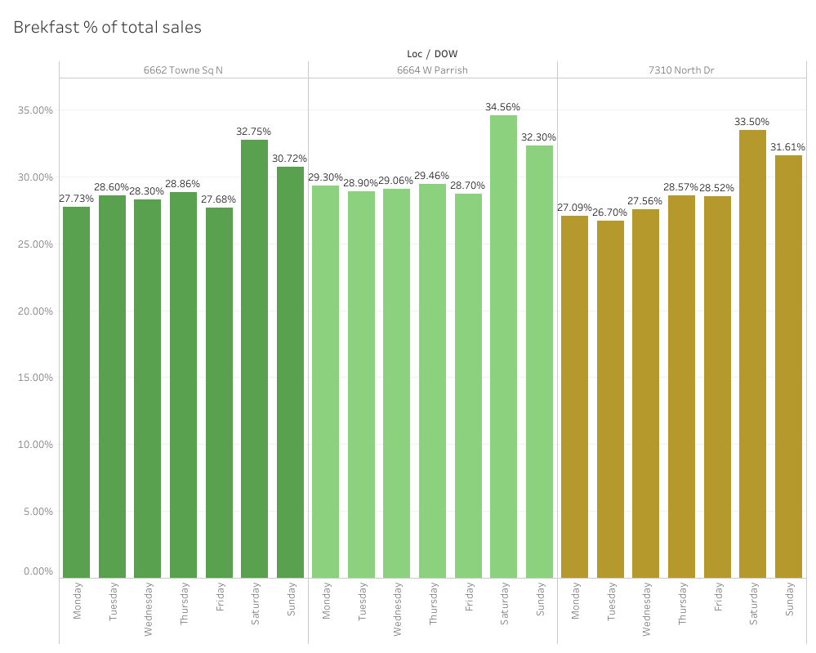
Breakfast % of total sales
Avg % increase: 3.5% 4.3% 4.9%
Sat/Sun

Slide 10
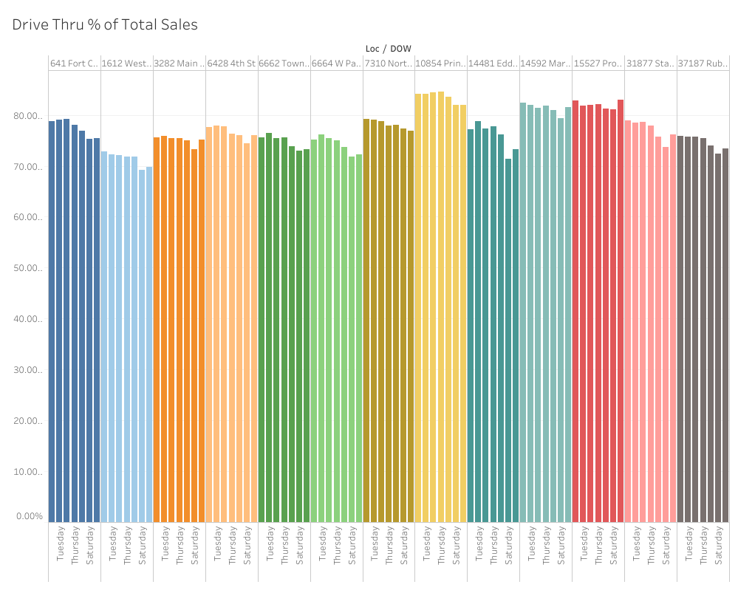

Slide 11
Analysis of previous chart
Each store has the most in store sales on Saturdays.
Princeton, Marion and Providence have the highest percent of sales in the drive thru. (see next slide)

Slide 12
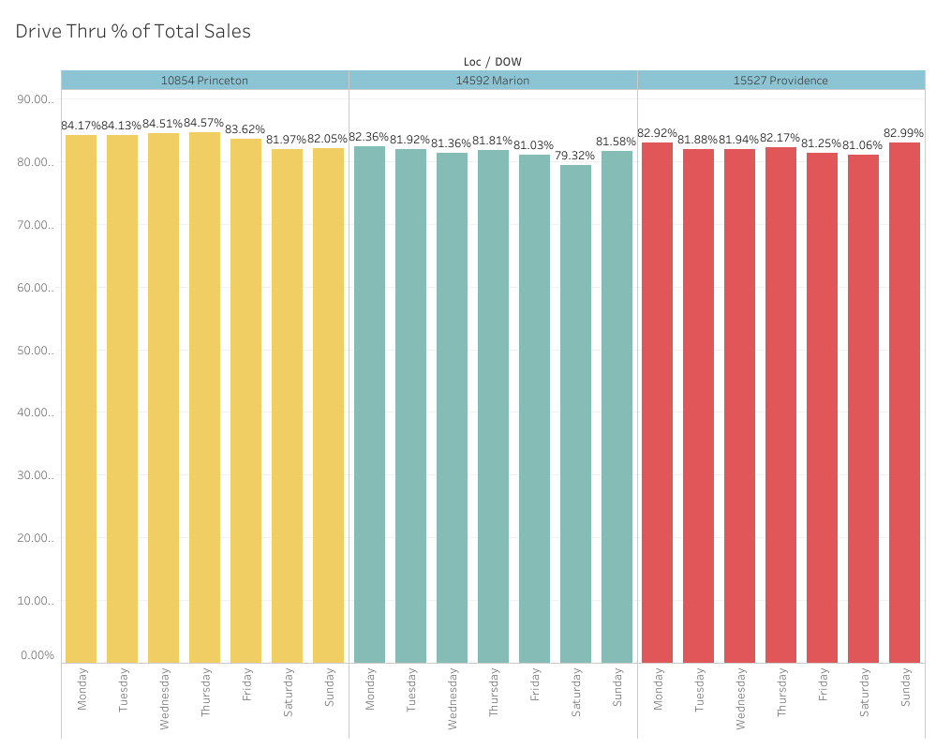

Slide 13
Some Data Driven Suggestions
Friday has the highest volume of customers, allow for proper staffing on these days.
4th St. (6428), State Rt 54 and Eddyville consistently have breakfast sales over 30%. Breakfast promotions at these locations may increase revenue.
Towne Sq North, Parrish and North Drive have significant spikes in breakfast sales on Saturdays and Sundays. Breakfast promotions at these locations on the weekends may increase revenue.
Princeton, Marion and Providence experience the highest percentage of drive thru traffic. Focus on drive thru efficiency at these locations.

